Slide 1
Introduction to F#
Basics of Functional Programming

Slide 2
About the Speaker
Chang Hai Bin
B.Sc. (Math), NUS
M.Sc. (Math), University of Michigan
(Current) Financial Engineer, Numerical Technologies
(Previous) Business Analyst, US-Mattress

Slide 3
What is Functional Programming (FP)?
Based on combinatory logic
Uses functions to solve problem
  Functions as objects
  Higher Order Functions
Other Good Properties (depend on language)
  Purity/Type-check/Recursive/Lazy-evaluation/homoiconicity

Slide 4
FP Languages
Static
Ancestor:
  ML (1973)
  Haskell (1990)
Cousins:
  OCaml(1996)
  Scala (2004)
  F# (2005)
  Elm (2012)
  ReasonML (2018)
Dynamic
Ancestor: LISP (1958)
Cousins:
  Scheme (1970)
  Common Lisp (1984)
  Clojure (2007)

Slide 5
Who uses FP? (Insert pictures here)
Haskell: Standard Chartered, Barclays
Ocaml: Jane Street (Trading Firm), Facebook (ReasonML)
F#: Microsoft, Walmart (Jet.com), Credit Suisse
Scala: LinkedIn, Twitter
Clojure: Deusche Bank, Amazon
Scheme: Naughty Dog (Game Developer)

Slide 6
Why Learn FP?
Concise code
Ability to reason
Unlock problems
Better Salary

Slide 7
This Talk: F#
(Statically Typed)
There are also Scala, Haskell, Clojure, Elm Meetups in Singapore.

Slide 8
Should I switch from C# to F#?
Early-adopter: Yes!
  Fun! Easy to Learn! Access other FP languages!
Normal-adopter: Yes.
  Use functional-technique in C# code.
Late-adopter/Skeptics: Maybe.
  A lot of new features in C# comes from F#.
  F# has better syntax to learn these concepts.

Slide 9
Core Concept
Functions are things
Compose functions

Slide 10
What is a function?
Function is a machine that take an input, and returns an output

Slide 11


Slide 12


Slide 13


Slide 14
F# Example
let f x = x + 5
f 30 // 35
f 100 // 105

Slide 15
Notation
 | Math | F#
Define | let f(x) = x + 5 | let f x = x + 5
Use | f(100) | f 100

Slide 16
let f x = “Hello” + x
f “John” // “Hello John”
f “Jane” // “Hello Jane”

Slide 17
let f x = String.length x
f “Hello” // 5
f “Computer” // 8
f : string -> int

Slide 18
let f xs = List.sum xs
f [1..10] // 55
f [2;3;5;7;11] // 28
f : List<int> -> int

Slide 19
Multiple inputs
let f x y = x + y
f 2 3 // 5
f 30 70 // 100
f : int -> int -> int

Slide 20
Notation
 | Math | F#
Define | let f(x,y) = x + y | let f x y = x + y
Use | f(30, 70) | f 30 70

Slide 21
Function Composition
Functions can be “connected” if the first output is the input of the second function.
Analogy: Jigsaw puzzle, connecting machines

Slide 22
let f x = String.length x
let g y = 1.0 / (float y)
g (f “Hello”) // g (5)
// 0.2
*Temporary ignore division by 0

Slide 23
let f x = String.length x
let g y = 1.0 / (float y)
f : string -> int
g : int -> float
*Temporary ignore division by 0

Slide 24
Types must match
let f x = String.length x
let g y = 1.0 / (float y)
f (g 5) FAIL!
g : int -> float
f : string -> int
Output of g not accepted by f

Slide 25
let f xs = List.sum xs
let g x =
if x > 80 then “A”
else if x > 60 then “B”
else “C”
g (f [20; 20; 50]) // g (90)
// “A”

Slide 26
let f xs = List.sum xs
let g x =
if x > 80 then “A”
else if x > 60 then “B”
else “C”
f : List<int> -> int
g : int -> string

Slide 27
|>
Key idea in F#
Pipe-forward operator

Slide 28
What does pipe-forward do?
Change the order of the function and input

Slide 29
let f x = x + 5
f 100 // 105
100 |> f // 105

Slide 30
let f x = String.length x
let g y = 1.0 / (float y)
g (f “Hello”) // 0.2
“Hello” |> f |> g // 0.2
*Temporary ignore division by 0

Slide 31
f : string -> int
g : int -> float
g (f “Hello”)
“Hello” |> f |> g

Slide 32
f : string -> int
g : int -> float
g (f “Hello”)
“Hello”
|> f
|> g

Slide 33
f : string -> int
g : int -> float
g (f “Hello”)
“Hello”
(then do) f
(then do) g

Slide 34
x
|> f
|> g
Start with input x,
Apply input to f,
Apply previous result to g.

Slide 35
x
|> f
|> g
|> h
Start with input x,
Apply input to f,
Apply previous result to g,
Apply previous result to h.

Slide 36
x
|> f
|> g
|> h
|> k
Start with input x,
Apply input to f,
Apply previous result to g,
Apply previous result to h,
Apply previous result to k.

Slide 37
x
|> f
|> g
|> h
|> k
Start with input x,
Apply input to f,
Apply previous result to g,
Apply previous result to h,
Apply previous result to k.
1st output = 2nd input
2nd output = 3rd input
etc.

Slide 38
x
|> f
|> g
|> h
|> k
In C#:
x.Pipe(f).Pipe(g).Pipe(h).Pipe(k);
You can do it in C#, but not as natural.

Slide 39
Benefit
Express Logic Step-by-Step
Easier to read

Slide 40
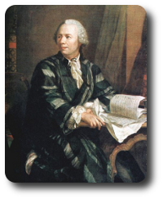

Example
Questions from Project Euler
https://projecteuler.net/

Slide 41
(Question 1) Find the sum of all the multiples of 3 or 5 below from 1 to 999.

Slide 42
(Question 1) Find the sum of all the multiples of 3 or 5 below from 1 to 999.
[1 .. 999]
|> List.filter (fun x -> x % 3 = 0 || x % 5 = 0)
|> List.sum

Slide 43
(Question 1) Find the sum of all the multiples of 3 or 5 below from 1 to 999.
[1 .. 999]
|> List.filter (fun x -> x % 3 = 0 || x % 5 = 0)
|> List.sum
Start with a list from 1 to 999
(then do) filter to keep the numbers you want
(then do) sum those remaining numbers.

Slide 44
(Question 1) Find the sum of all the multiples of 3 or 5 below from 1 to 999.
[1 .. 999]
|> List.filter (fun x -> x % 3 = 0 || x % 5 = 0)
|> List.sum
C# LINQ
Enumerable.Range(1, 999)
.Where(x => x % 3 == 0 || x % 5 == 0)
.Sum();

Slide 45
(Question 6 Modified)
Calculate 1² + 2² + ... + 100²

Slide 46
(Question 6 Modified)
Calculate 1² + 2² + ... + 100²
[1 .. 100]
|> List.map (fun x -> x * x)
|> List.sum

Slide 47
(Question 6 Modified)
Calculate 1² + 2² + ... + 100²
[1 .. 100]
|> List.map (fun x -> x * x)
|> List.sum
Start with a list from 1 to 100
(then do) convert each element to its square
(then do) sum up the previous list.

Slide 48
(Question 6 Modified)
Calculate 1² + 2² + ... + 100²
[1 .. 100]
|> List.map (fun x -> x * x)
|> List.sum
In C#:
Enumerable.Range(1,100)
.Select(x => x * x)
.Sum();

Slide 49
Partial Application
let AddAll w x y z = w + x + y + z
AddAll 1 2 3 4 // 10
AddAll 1 2 3

Slide 50
public static int Add (int x, int y){
return x + y;
}

Slide 62
Learn more about F#

Slide 63
Where to learn?
FSharpforfunandprofit blog
  https://fsharpforfunandprofit.com/
Real-World Functional Programming
  https://www.manning.com/books/real-world-functional-programming

Slide 64
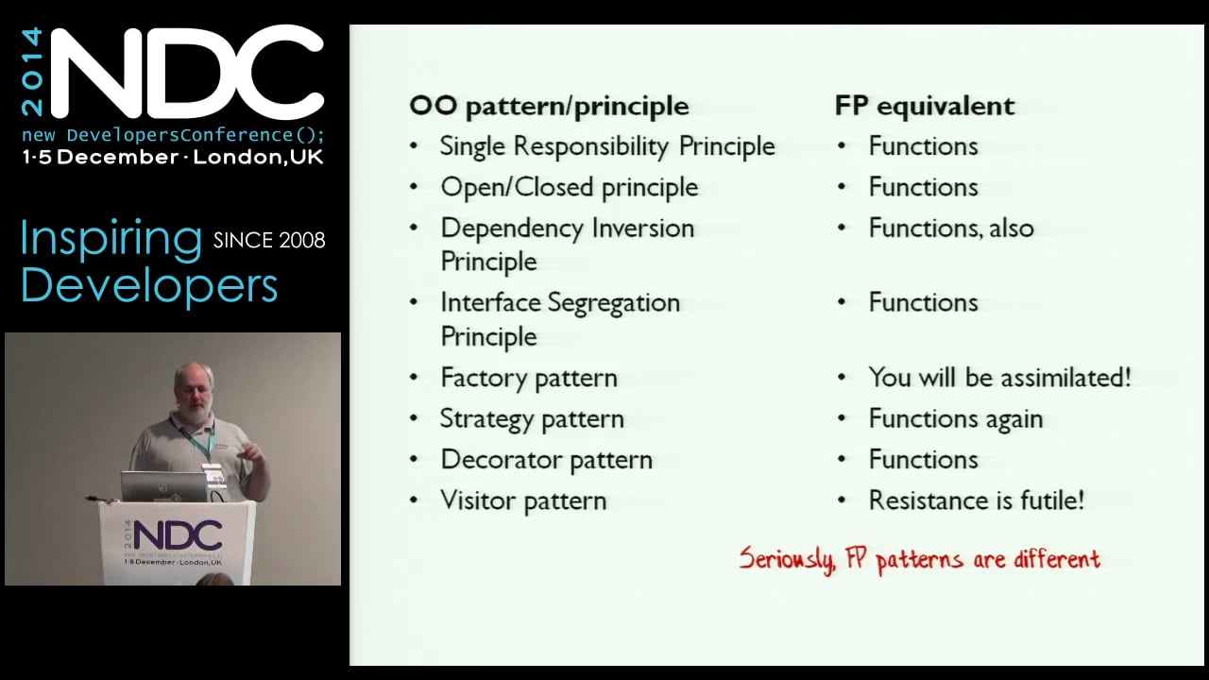
Conference videos?
Scott Wlaschin (author for F#forfunandprofit)
  Great tech educator.
  Given many good talks during NDC Conference. (Available on Youtube)

Slide 65
How to learn?
Try out Project Euler Questions.
Avoid using conventional programming technique.
https://fsharpforfunandprofit.com/learning-fsharp/
I have some training materials for interns.

Slide 66
Sources (Who uses FP)
https://www.janestreet.com/technology/
https://reasonml.github.io/
https://fsharp.org/testimonials/
https://devblogs.nvidia.com/jet-gpu-powered-fulfillment/
https://www.scala-lang.org/old/node/1658
https://clojure.org/community/companies
https://www.slideshare.net/naughty_dog/statebased-scripting-in-uncharted-2-among-thieves

